Slide 1
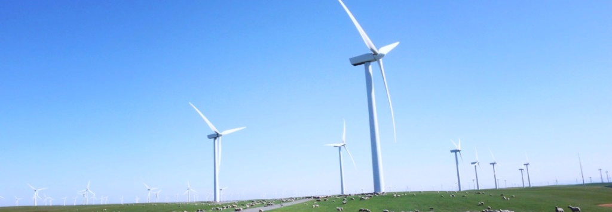
Mr. Richard G. Newell is Professor of Energy and Environmental Economics at the Nicholas School of the Environment, Duke University and Director of the Duke University Energy Initiative. In 2009, he was confirmed by the Senate as the head of the U.S. Energy Information Administration (EIA), the agency responsible for official U.S. government energy statistics and analysis, where he served until 2011. Mr. Newell has also served as the Senior Economist energy and environment on the President's Council of Economic Advisors. He is on the Board of Directors and is a University Fellow of Resources for the Future, where he was previously a Senior Fellow. He is a Research associate of the National Bureau of Economic Research and has provided expert advice and consulted with many private, governmental, non-governmental, and international institutions
学 术 报 告
COMPARING EMISSIONS MITIGATION EFFORTS ACROSS COUNTRIES
Billy Pizer, Duke University
Professor in the Sanford School of Public Policy and Faculty Fellow at the Nicholas Institute for Environmental Policy Solutions
10:30-11:30 a.m. | Sept. 8 |
Room 512, National School of Development
Prof. Billy Pizer holds joint appointments as professor in the Sanford School of Public Policy at Duke University and as a faculty fellow in the Nicholas Institute for Environmental Policy Solutions. His current research examines how public policies to promote clean energy can effectively leverage private sector investments, how environmental regulation and climate policy can affect production costs and competitiveness, and how the design of market-based environmental policies can be improved. From 2008 until 2011, he was Deputy Assistant Secretary for Environment and Energy at the U.S. Department of the Treasury, overseeing Treasury’s role in the domestic and international environment and energy agenda of the United States. Prior to that, he was a researcher at Resources for the Future for more than a decade.
Abstract:
A natural outcome of the emerging pledge and review approach to international climate change policy is the interest in comparing mitigation efforts among countries. Domestic publics and stakeholders will have an interest in knowing if peer countries are undertaking (or planning to undertake) comparable efforts in mitigating their greenhouse gas emissions. Moreover, if the aggregate efforts are considered inadequate in addressing the risks posed by climate change, then this will likely prompt a broader interest in identifying those countries where greater efforts are arguably warranted based on comparison with their peers. Both assessments require metrics of efforts and comparisons among countries. This study proposes a framework for such an exercise, and presents a template for organizing metrics on mitigation efforts, for both ex ante and ex post review.

